Slide 1
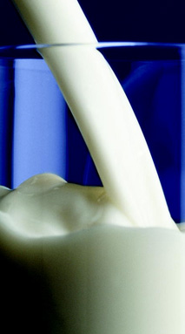

Milk Consumption and Dairy Industry in China
Dr Hong Chen (FNZIFST)
To Hibiscus Coast branch, 29 July 2011

Slide 2
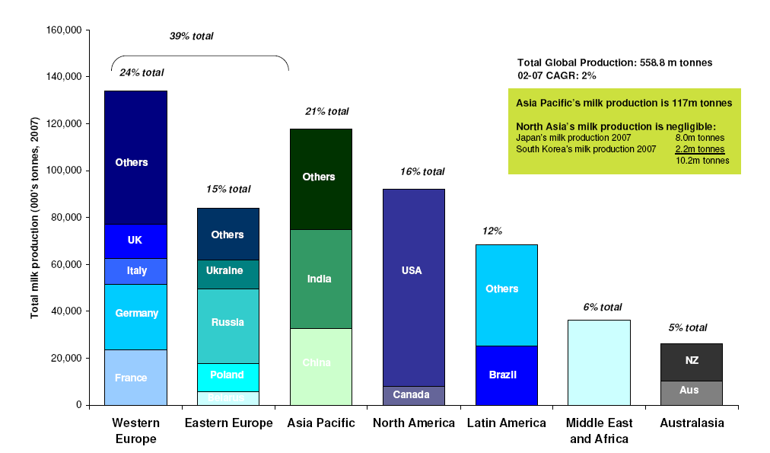
Global milk production
(From Food and Agriculture Organization of UN: FAOSTAT, DAC statistics, Mckinsey analysis)
Total Global Annual Production is 558.8 million metric tonnes (m Mts)
China’s milk production is 35.2 m Mts,
= 6.3% of global production
NZ’s milk production is 17m Mts.
= 3% of global production
China

Slide 3
Milk Production in China
(From FSG analysis, China Knowledge, EIU )
>5,000
2,000 -5,000
800-2,000
<800
Milk production volume, 2011 estimated
Heilongjiang
4,100
Inner Mongolia
11,200
Jilin
Xinjiang
1,700
Liaoning
1,100
Beijing
Hebei
6,200
Tianjin
800
Ningxia
800
Shanxi
Shandong
3,900
QinghaI
Gansu
Henan
3,600
Jiangsu
Shaanxi
1,400
Anhui
Shanghai
Tibet
Hubei
Sichuan
Chongqing
Zhejiang
Hunan
Jiangxi
Fujian
Guizhou
Yunnan
Guangxi
Guangdong
10 region total volume: ~ 35 million tons
Total number of cows: ~ 8 million
Hainan

Slide 4

Actual and projected population of China, 1950-2050
China’s population
(From United Nations, World Population Prospects. New York (1999))
42% of population > 50 years by 2050
China has a high birth rate 12.3 while population aging will emerge in China more quickly than in other countries
Source: United Nations (1999): World Population Prospects. New York

Slide 5
China’s population growth and urbanization
Number of new-born baby in China each year
  Average annual - 18 Million (=1.5 million per month or 49,000 per day)
No. of cities with >10 million to 1 million (in 2010)
  > 10 million: 3 (Beijing, Shanghai, Chongqing)
  > 2 million: 36
  > 1 million: 119
  By 2025
  > 10 million: 8
  > 5 million: 23
  > 1 million: 221
    Note:
    1st tier cities = large cities and provincial capitals
    2nd tier city = medium sized cities (> 1 million)
    3rd tier cities = small sized cities (< 1 million) - about 500 cities

Slide 6
China Dairy Snapshot (best estimation)
Dairy Cows (total) 8 million cows
Average cows /farm 87% have less than 200 cows
66% have less than 20 cows
Milk yield (Mt /cow /year) 2.5Mts
Dairy products consumption per capita 12.1kg
Drinking milk consumption per capita 10.1kg
Yogurt and sour milk drinks
consumption per capita 2.0kg

Slide 7
China – economic development
In China, consumption gradually becoming the most important economic growth driver.
Middle class growing fast; income distribution widening further
  According to Euromonitor International, China’s middle class, which stood at 80 million people in 2007, is expected to soar to 700 million by 2020
Urbanization redefining city landscape and scale – more consumer market growth coming from lower-tier cities.
  McKinsey Global Institute has estimated that more than 1 billion people will be living in cities in China by 2030, compared with about 600 million in 2008.

Slide 8
China – economic development
Chinese government continuing to focus on maintaining “sustainable development” and building a “harmonious society”.
As a result of all these changes, China posed to become the Number 3 consumer market worldwide by 2015.
China is expected to be one of the fastest growing markets for liquid dairy (Tetra Pac’s report in 2011).

Slide 9
Chinese traditions for Dairy products
Dairy products were not in the normal Chinese diet
Only liquid town milk and WMP* were used by baby, patient, or elderly
Chinese people like sweet milk (they add sugar) with strong creamy and cooked flavor
Chinese people preferred to drink milk in warm
Chinese people believed dairy products were healthy and nutritional foods
* WMP = Whole Milk Powder

Slide 10
Changes of the traditions
Middle class growing fast; income increased, improve life quality.
Chinese people still regard dairy products are healthy and nutritional foods, and would like to have them in the daily diet
Younger generations have adopted a more Western lifestyle, including a more Western diet, e.g. a traditional breakfast of noodles is slowly being replaced by milk and bread.
Many Chinese are starting to drink milk for the first time, particularly dairy beverages*, while population growth is driving demand for baby and toddler milk
* dairy beverage = fermented milk, often flavoured, e.g. strawberry or chocolate.

Slide 11
Dairy products
The popular dairy products in China
Milk drinks – eg: UHT, pasteurized milk, flavored milk drinks
Yoghurt
Ice cream
Milk beverages – fermented milk drinks,
Infant formula powders
Cheese for pizza – fast food chains
Cream for bakery – western style cakes
According to Tetra Pak research (2011): Demand for Chinese Liquid Dairy Products (LDP) is expected to surge by more than 40% between 2009 and 2013 – from around 25 billion litres to some 35 billion litres – driven by more than a 60% rise in consumption of lactic acid drinks and more than a 50% increase in consumption of baby and toddler milk

Slide 12
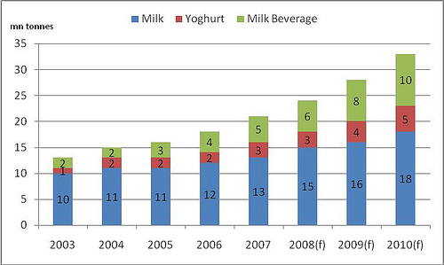
Chinese Dairy Consumption
2003 to 2010 (From the internet)

Slide 13
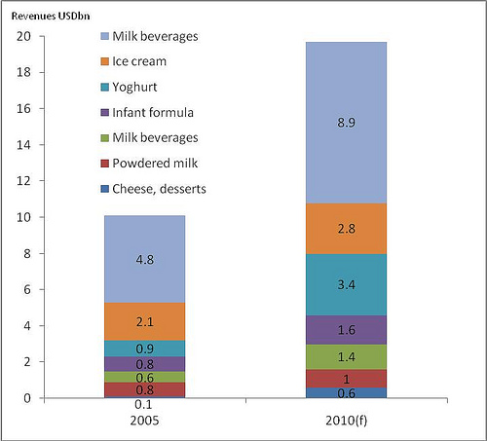
Revenues of Dairy products in China in 2005 and 2010 (From the internet)

Slide 14
Chinese Dairy industry
Dairy companies in China
In 2009, there ware 1176 dairy companies in China.
In 2010, Only 643 dairy producing companies (about 55 percent ) were granted licenses to continue production by the General Administration of Quality Supervision, Inspection and Quarantine (AQSIQ)
426 dairy producers were forced to be shut down and another 107 were suspend operations following a quality watchdog inspection
The major Chinese dairy companies are:
  Inner Mongolia: Mennui Dairy (Group) Co. Ltd,
  Inner Mongolia: Yili Industrial Group Co. Ltd
  Shanghai: Bright Dairy Group [major stakeholder in NZ Synlait Milk] ,
  Beijing: Shanyan Dairy Group
  Hailongjiang: Wondersun Dairy Co Ltd
Nestle, Coca-Cola and Danone are currently the biggest foreign companies in the Chinese dairy market – which is dominated by drinking yoghurts and flavoured milks

Slide 15
Challenges in Chinese Dairy industry
Consumer's concerns on food safety
Growth demand for high quality dairy products
Establish a trusted quality assurance system

Slide 16
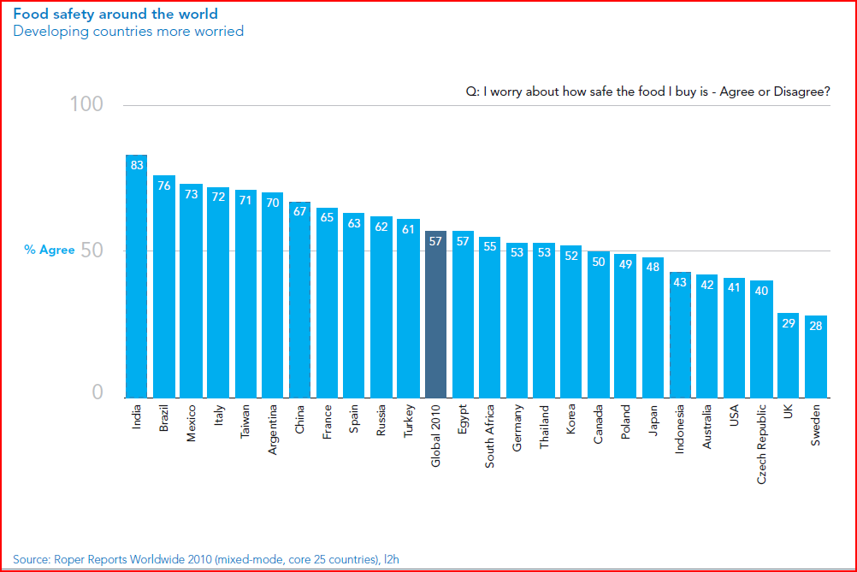
Food safety concerns

Slide 17
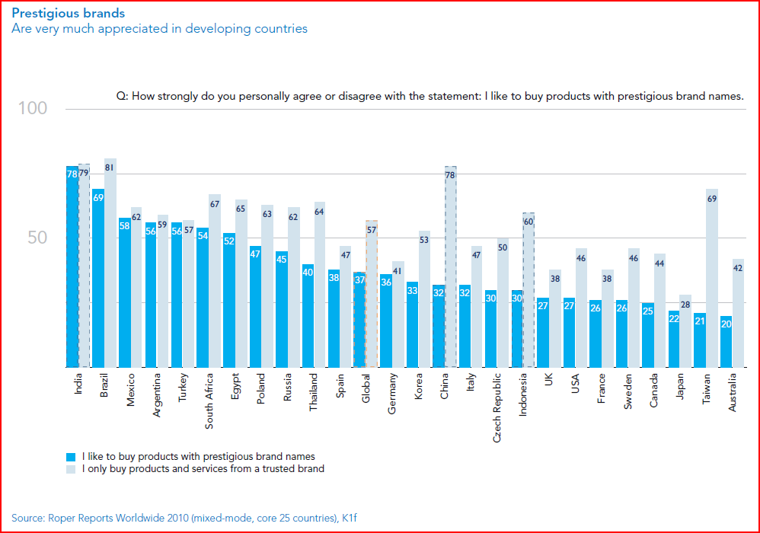
Prestigious brands

Slide 18
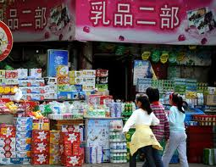
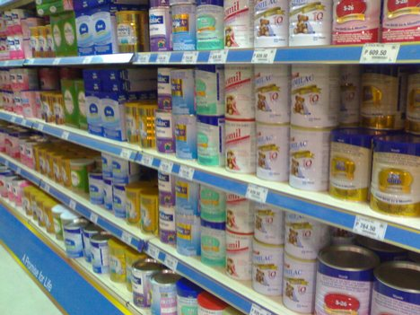
dairy products in supermarket and retailer

Slide 19
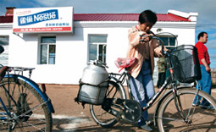
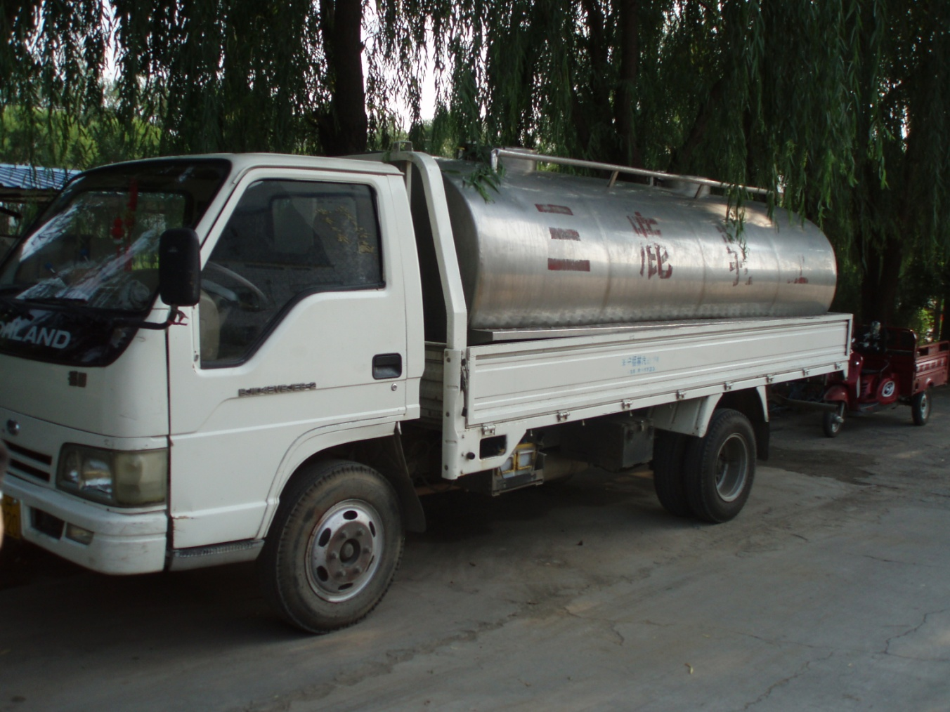
milk transportation

Slide 20
The end of presentation
Thanks for your interests and listening
Any questions

